Slide 1

JAVA SCRIPT(JS)

Slide 2
General Guideline
© (2024) ABES Engineering College.
This document contains valuable confidential and proprietary information of ABESEC. Such confidential and proprietary information includes, amongst others, proprietary intellectual property which can be legally protected and commercialized. Such information is furnished herein for training purposes only. Except with the express prior written permission of ABESEC, this document and the information contained herein may not be published, disclosed, or used for any other purpose.

Slide 3
Variables, Data types, Scope, Type coercion, Function, Conditionals, Object, Array, Window, DOM, Selectors, DOM Manipulation, Events, Form handling, First Class Citizen
Content
Day 4

Slide 4
var: Oldest keyword Variables declared outside the function can be accessed globally Function scoped () { … } var accessed within the scope (before initialization) (no error) → undefined Redeclaration ALLOWED
Content
Variables in JS

Slide 5
let: Introduced in ES6 / EcmaScript-2015 Block scope { … } Accessed within the scope (before initialisation) ( ReferenceError ) → Cannot access ... before initialisation Redeclaration NOT ALLOWED ( SyntaxError ) → Identifier ... has already been declared
Content
Variables in JS

Slide 6
const: Introduced in ES6 / EcmaScript-2015 Block scope { … } Accessed within the scope (before initialisation) ( ReferenceError ) → Cannot access ... before initialisation uncaught Redeclaration NOT ALLOWED ( SyntaxError ) → Identifier ... has already been declared Reassignment NOT ALLWED ( TypeError ) → Assignment to constant variable. Declaration without initialisation NOT ALLOWED ( SyntaxError ) Missing initialiser in const declaration
Content
Variables in JS

Slide 7

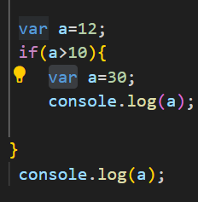
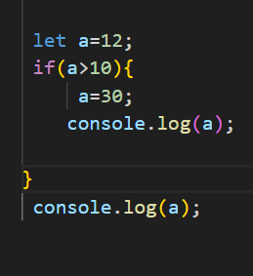
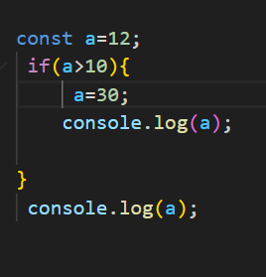


var let const
Content
Variables in JS
Use Before declaration/initialization

Slide 8
Primitive (Value Types) A primitive value is a value that has no properties or methods. String, Number, Boolean, Undefined, Null, BigInt, Symbol. Non-primitive (Reference Types) Object, Array Date, Set, Map
Content
Datatypes in JS

Slide 9
Is javascript a strictly typed language? It is loosely typed language as well as dynamically typed language string —> ‘ ’ or “ ” array —> [ ] object —> { } to check type of the variable —> typeof
Content
JS in Everyday Use

Slide 10
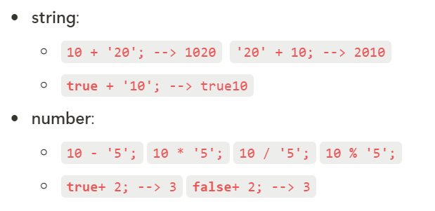
automatic or implicit conversion of values from one data type to another
Content
Type coercion

Slide 11
== and === Template Literals ES6 Features == (should be avoided) `…. ${} ….` equality with type coercion loose equality === equality without type coercion strict equaltiy
Content
Type coercion

Slide 12
a function is a "subprogram" that can be called by code external (or internal, in the case of recursion) to the function. Like the program itself, a function is composed of a sequence of statements called the function body. Values can be passed to a function as parameters, and the function will return a value. Function values are typically instances of Function, By default, if a function's execution doesn't end at a return statement, or if the return keyword doesn't have an expression after it, then the return value is undefined. function fun(){ console.log(“Having with JS”); } fun(); const result=fun();
Content
Function in JS
function fun() { return “Having fun with JS” }

Slide 13
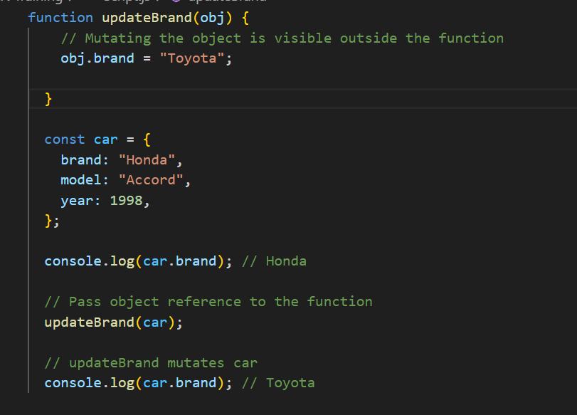
Passing Argument as Object: function ubpdateBrand( obj){ }
Content
Function in JS

Slide 14
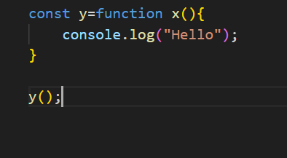
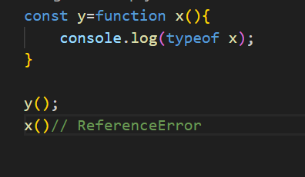
Function as expression:
Content
Function in JS
Tips: x would be local, not be accessible outside this function.

Slide 15
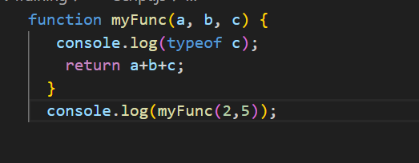
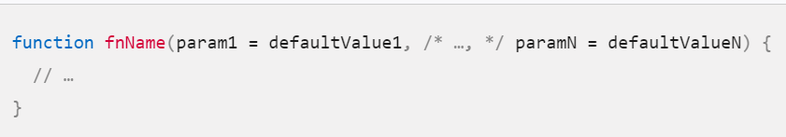
Default parameters: Default parameters allow formal parameters to be initialized with default values if no value or undefined is passed. Test: check with string data with numeric value also in code.
Content
Function in JS

Slide 16
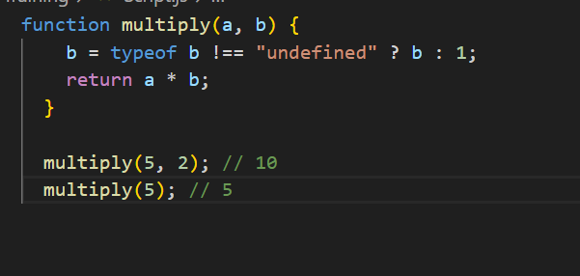
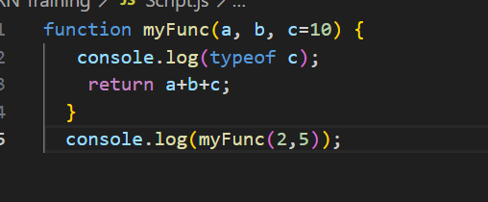
Default parameters continue:
Content
Function in JS

Slide 17
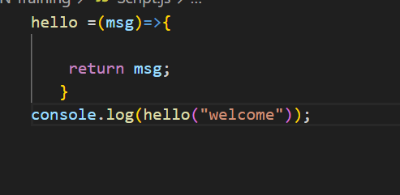
Arrow function: An arrow function expression is a compact alternative to a traditional function expression, with some semantic differences. hello = () => { return "Hello World!"; }
Content
Function in JS

Slide 18
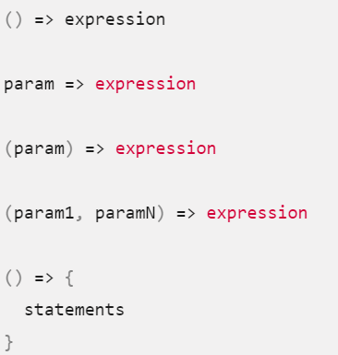
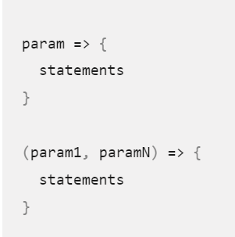
Syntax
Content
Function in JS

Slide 19
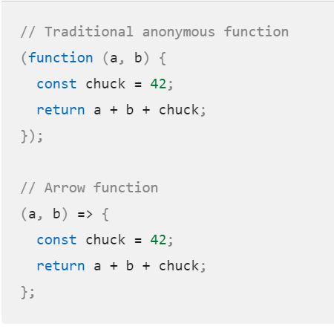
Tradition anonymous Vs Arrow function
Content
Function in JS

Slide 20
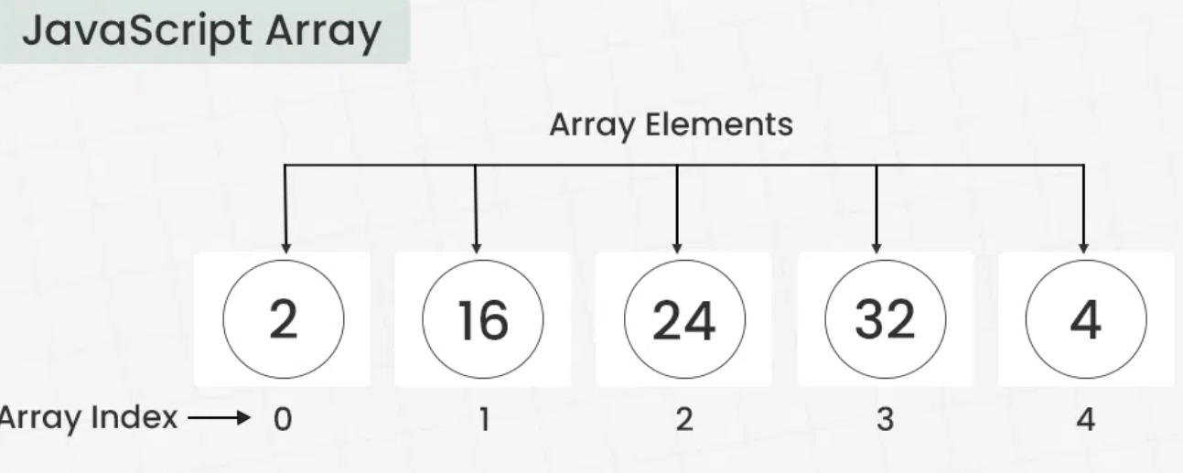
Content
Array in JS

Slide 21
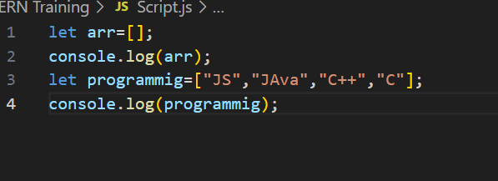

Array Literals: Array Constructor:
Content
Array in JS

Slide 22
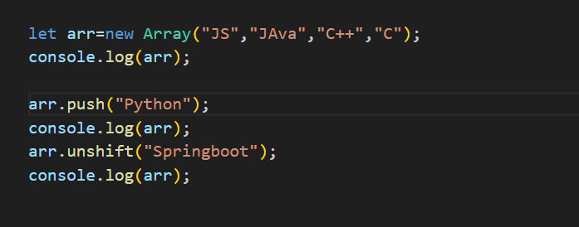
Operation need to perform: Indexing, Accessing elements from array, iterate(in,of) Adding element to array: The push() method add the element to the end of the array. The unshift() method add the element to the starting of the array.
Content
Array in JS

Slide 23
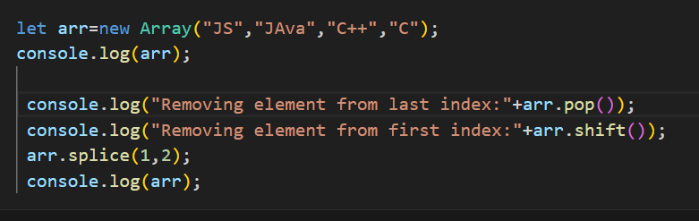
Removing Element in Array: The pop() method removes an element from the last index of the array. The shift() method removes the element from the first index of the array. The splice() method removes or replaces the element from the array.
Content
Array in JS

Slide 24
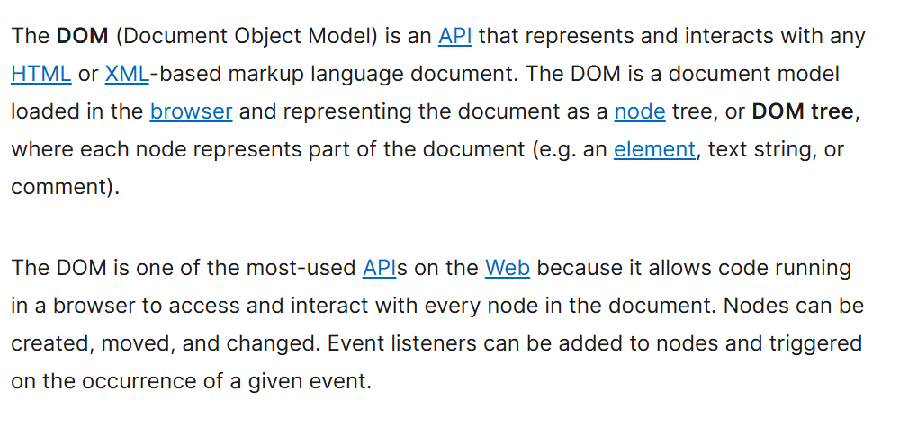
Content
DOM

Slide 25
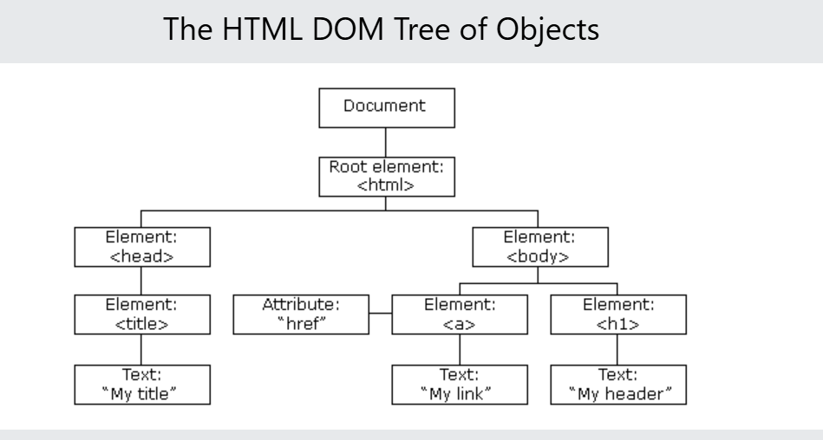
Content
DOM Tree

Slide 26
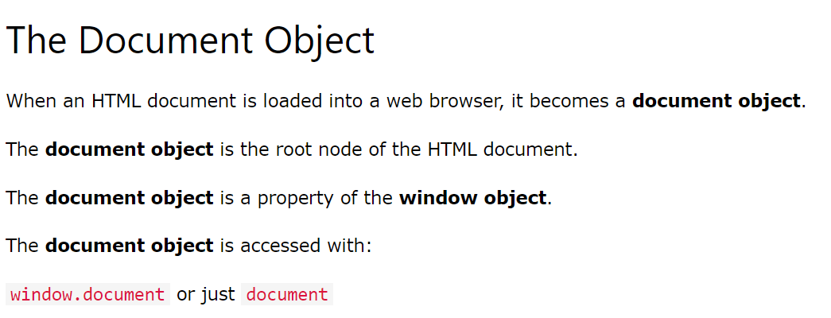
Content
Basic Document

Slide 27
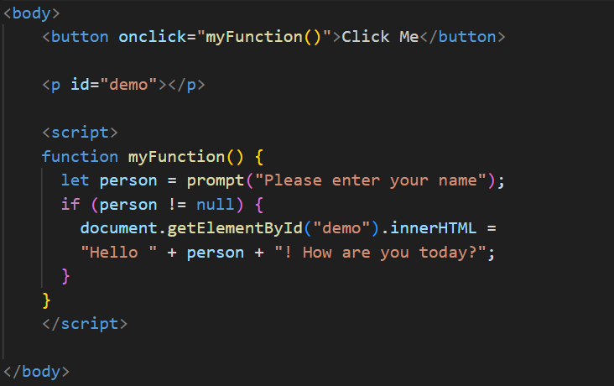
Content
Basic event handling

Slide 28
By ID getElementById() returns The element with the specified id. null (if the element does not exist) By Class getElementsByClassName() returns A collection of elements with the specified class name. The elements are sorted as they appear in the document. Works on getElementsByTagName() and querySelector();
Content
Element Selectors

Slide 29
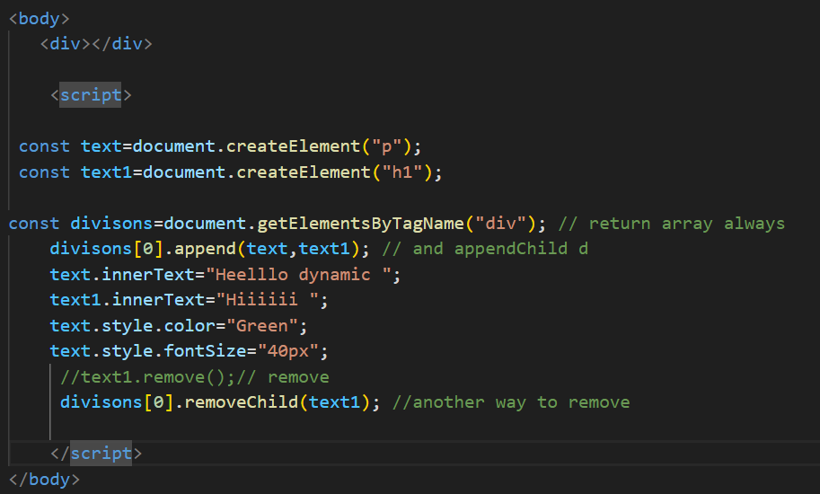
Content
Create new element
Discuss console.log(document) and
console.dir(document)

Slide 30
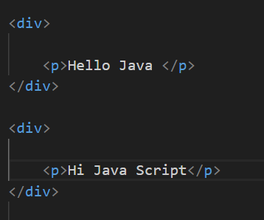
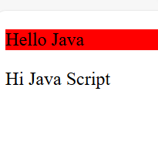
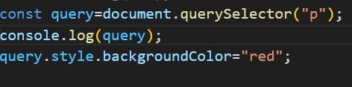
QuerySelector: The querySelector() method returns the first element that matches a CSS selector. Html JS Output
Content
Event handling

Slide 31
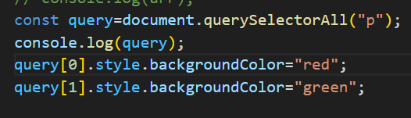
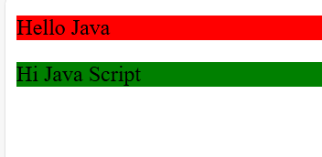
QuerySelectorAll: To return all matches (not only the first), use the querySelectorAll() instead. Html JS Output
Content
Event handling

Slide 32
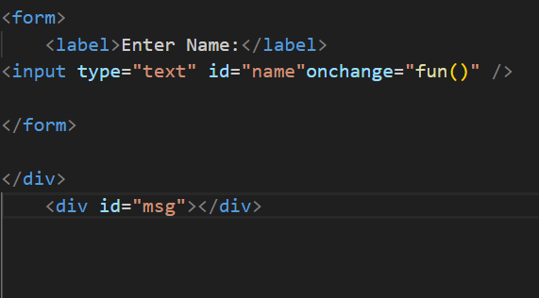
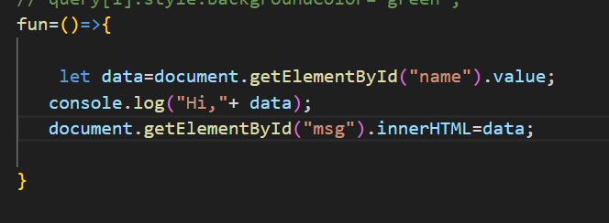
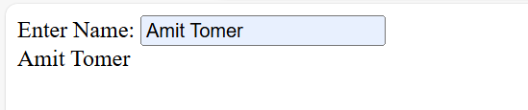
Evenet:onchange HTML JS Output
Content
Event handling

Slide 33
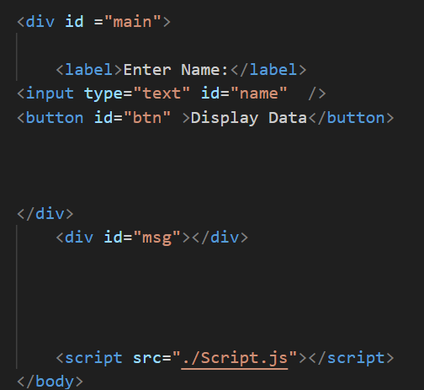
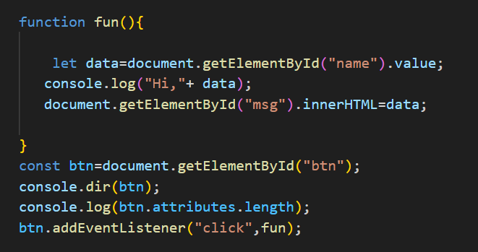
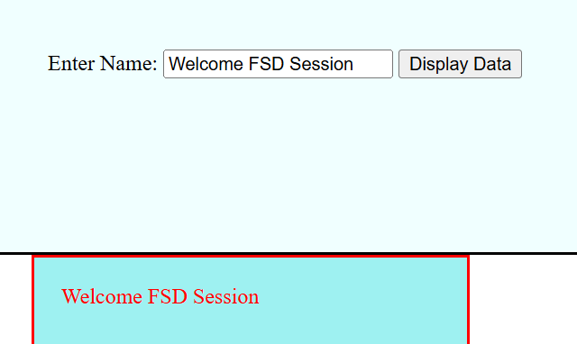
Evenets: addListener HTML Script.js Output
Content
Event handling

Slide 34
https://developer.mozilla.org/
Reference
https://developer.mozilla.org/
https://www.w3schools.com/

Slide 35
Thank You

